Slide 1
Welcome to Today’s Webinar!
Using Data to Identify Programmatic Interventions
This event will start at 11:00 a.m. E.T.

Slide 2
Welcome to Today’s Webinar
Audio Information
Dial: 888-469-1670
Conference ID: 2658959
If you have technical difficulties logging
into the web-based portion of the event,
please contact Live Meeting Customer
Support at 1 (866) 493-2825.
If you have any questions about the Live
Meeting technology or the Webinar,
please contact SSSTA at sssta@air.org.

Slide 3
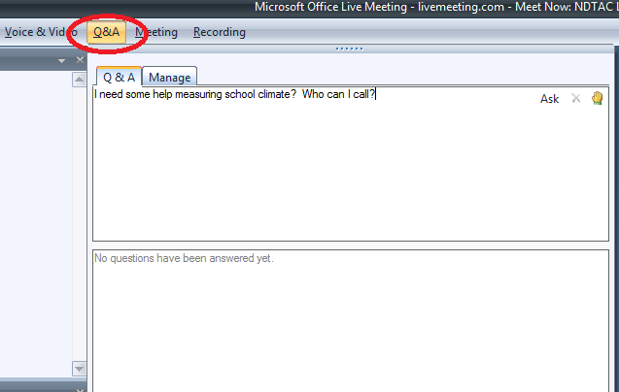
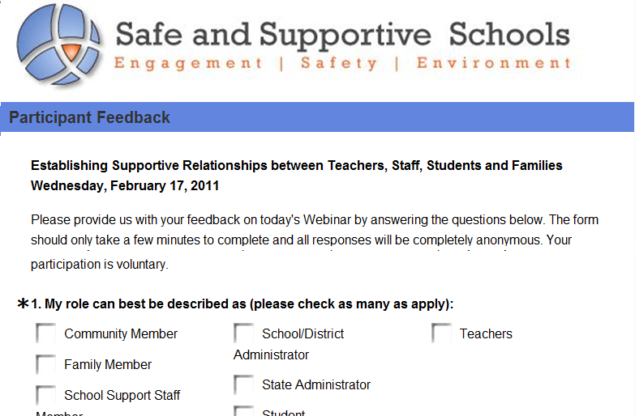
Questions, Event Evaluation &
Contact Information
Q&A
Evaluation
If you have a question for the presenters, please type it in the Q & A Pane or email sssta@air.org during the Webinar.
An event evaluation will appear as the last slide in the presentation. Please input your answers directly into the slide. All answers are completely anonymous and are not visible to other participants.
For assistance during the Webinar, please contact
the Safe and Supportive Schools Technical Assistance Center
at sssta@air.org.

Slide 4
The Safe and Supportive Schools
Technical Assistance Center
Funded by the U.S. Department of Education’s Office of Safe and Healthy Students.
Provides training and support to states, including 11 grantees funded under the Safe and Supportive Schools Program and other state administrators; administrators of districts and schools; teachers; support staff at schools; communities and families; and students.
Goal is to improve schools’ conditions for learning through measurement and program implementation, so that all students have the opportunity to realize academic success in safe and supportive environments.
*The content of this presentation was prepared under a contract from the U.S. Department of
Education, Office of Safe and Healthy Students to the American Institutes for Research
(AIR). This presentation does not necessarily represent the policy or views of the U.S.
Department of Education, nor do they imply endorsement by the U.S. Department of
Education.

Slide 5
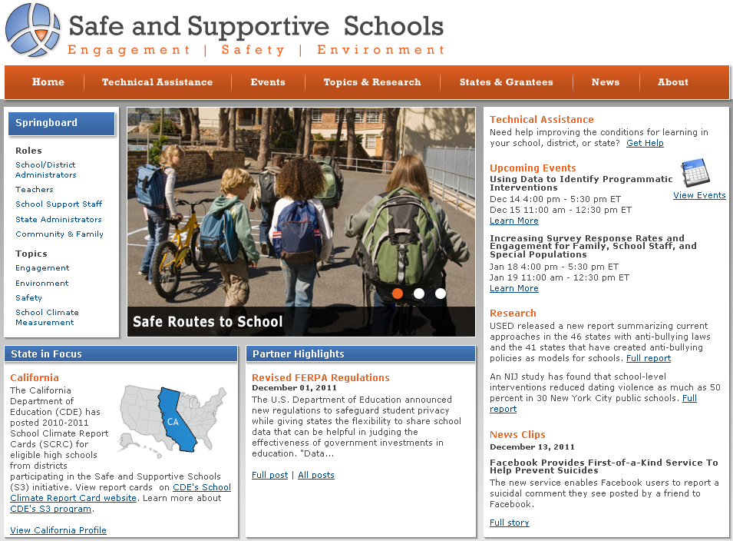
Safe and Supportive Schools Website
http://safesupportiveschools.ed.gov

Slide 6
Polling Question #1
Which of the following best describes your current role?
  State Education Personnel
  District or School Administrator
  Teacher or School Support Staff
  Community or Family Representative
  Student
  Researcher
  Other
Notes:
As participants respond, discuss how material today will relate to the various audiences identified here. Characterize pattern as people answer polling question.

Slide 7
Polling Question #2
Which of the following reflects your most pressing issue?
  Using school climate data to identify needs
  Identifying types of programmatic interventions
  that can address identified needs
  Selecting programmatic interventions that can be
  implemented effectively within a school or district

Slide 8

Using Data to Identify Programmatic Interventions
David Osher, Ph.D., American Institutes for Research
Notes:
8

Slide 9
Agenda
1
About programmatic interventions
2
Using data to identify programmatic intervention needs
3
Identifying the type of programmatic intervention(s) needed to address needs
4
Selecting programmatic interventions that can be implemented effectively within a school or district

Slide 10
About Programmatic Interventions

Slide 11
What Do We Mean by Programmatic Interventions?
Any program, strategy, activity, service, or policy for school or community settings that:
  creates positive relationships between students and adults
  promotes parent and community engagement
  promotes the character, social, and emotional development of students
  prevents and reduces youth crime, violence, harassment, bullying, and the illegal use of drugs, alcohol, and tobacco
  enables school communities to manage student behaviors effectively while lowering suspensions and expulsions
  provides other needed social and emotional supports for students
  provides or improves access to social services

Slide 12
On What Evidence Should Programmatic Interventions Be Based?
Programmatic interventions should be based on matching the needs and capacities of the local context with the best available evidence, including, where available, strong or moderate evidence.
  Strong evidence means evidence from studies with designs that can support causal conclusions (i.e., studies with high internal validity), and studies that, in total, include enough of the range of participants and settings to support scaling up to the State, regional, or national level (i.e., studies with high external validity).
  Moderate evidence means evidence from previous studies with designs that can support causal conclusions (i.e., studies with high internal validity) but have limited generalizability (i.e., moderate external validity) or from studies with high external validity but moderate internal validity.

Slide 13
What Challenges Do Schools and Districts Often Face?
Using school data to identify what types of interventions are needed.
Selecting the interventions that you will be able to implement to address your particular needs.

Slide 14
Planning Model
Notes:
This ppt is addressing steps 1-3

Slide 15
1. Systematically Review Data to
Identify Needs
Bring together school climate team.
      - Ideally use a current group to review data, and plan and implement programmatic interventions.
      - Creating a parallel team is not efficient.
      - Parallel teams can reduce value.
      - Parallel teams usually separate climate from the academic mission of school.
      - Focus on school’s human resources and time.
Make it inclusive yet efficient.
Connect to intervention team(s) (e.g. Student Support
Teams).

Slide 16
1. Systematically Review Data to
Identify Needs (continued)
Analyze data to determine need and prevalence of need.
Align with existing vision statement plans for school/district (e.g.,School Improvement Plans; District Strategic Plans).
Select target areas related to identified needs (e.g., what are the specific areas of interest; intended outcomes).

Slide 17
Logic Model: Approach to Using Data to
Identify Programmatic Interventions

Slide 18
Logic Model: Approach to Using Data to
Identify Programmatic Interventions
2
1

Slide 19
Logic Model: Approach to Using Data to
Identify Programmatic Interventions
3
2
1

Slide 20
Logic Model: Approach to Using Data to
Identify Programmatic Interventions
3
2
4
1

Slide 21
2. Assess Current Programmatic
Interventions Relating to Your Needs
Identify relevant programmatic interventions that are currently in place within the school.
Review the data for current programmatic interventions (e.g., outcome and process data, what is and is not working well).
Identify other programmatic interventions that address target area and needs.
Review and discuss programs and practices in relation to:
    Need
    Fit
    Resources – sustainability
    Strength of evidence
    Readiness for replication
    Capacity to implement
Citation ▪ 1

Slide 22
3. Identify Change(s) or Needed
Programmatic Interventions
Select programmatic interventions for consideration based on assessment results.
Develop methods to promote consideration and gain “buy-in” for a range of impacted stakeholders.
  Address different level’s of readiness and interests.
  Listen to logistical concerns and recommendations on how to implement.
  Consider example of Cleveland’s decision to use PATHS.
Analyze and use the information and results of these activities.
Recommend selected programmatic interventions to building, district, or state leadership.

Slide 23
Questions?
If you have a question for the presenter, please type it in the Q & A Pane or email sssta@air.org.
?
?
?

Slide 24
Using Data to Identify Programmatic Intervention Needs
Notes:
Explain that schools most often struggle with using their data, selecting the type programmatic interventions needed, and then selecting the programmatic interventions that can be implemented successfully. The rest of the presentation will focus on these challenges.

Slide 25

The First Challenge: How to Interpret and Use All the Data

Slide 26
How Can Data Be Used?
Identify needs.
  What is the issue?
  Who does it involve?
  What are the targets of the intervention and where to intervene?
Identify interventions.
  Is there evidence of program effects?
Monitor and evaluate.
  How is the intervention being implemented?
  Is it realizing short term benchmarks?
  What were the results of implementing the intervention?

Slide 27

What Is the Problem?
Where Do You Intervene?
Is it:
  The fish (individuals)
  The water (the ecology)
  Both
Is it:
  The fish (individuals)
    e.g., Universal SEL and targeted anger management
  The water (ecology)
    e.g., PBIS
  Both
    e.g., PBIS plus wrap around and/or SEL
Citation ▪ 2

Slide 28
What Are the Root Causes And How Can They Be Addressed?
Do not just address symptoms (e.g. troubling behavior).
Determine what the factors that underlie the problem OR gap are.
  Why is it happening or absent?
  What can be done to prevent it from happening again or to (if there is a gap) promote it?
  Are there “low hanging fruit” and are they the right fruit?

Slide 29

Why Use Data to Identify Programmatic Interventions?
An analysis of strengths and needs helps determine what programmatic interventions should address.
Comprehensive reviews of quantitative and qualitative data are key to making the best choices.

Slide 30

What Data Are Needed to Identify Programmatic Interventions?
Information That Can Be Quantified:
  School climate survey data (e.g., items on engagement, safety, support, environment)
  School archival data (e.g., attendance, graduation rates, truancy)
Qualitative and Descriptive Information:
  Qualitative data (e.g., focus groups, interviews)
  Information on school programs (e.g., how many, which, staffing, students served, outcomes for different groups of students)
  Information on related community programs (e.g., health, tutoring programs that may be housed or serve students after school)

Slide 31
What are the Strengths and Limits of Different Types of Data?
Surveys
  Breadth
  Confidentiality
  Quantifiable
  Can measure attitudes and perceptions
Focus Groups and Interviews
  Depth
  Meaning and nuance
  Less quantifiable
Archival Data
  Behavioral patterns
  Dependent on “Natural Raters” (e.g., decision to suspend)
  Assessments

Slide 32
Which Measures Should Be Used?
It depends on the measure and how it can be interpreted.
  Which measures could have policy implications?
    (e.g., Achievement; school removal?)
  Which measures could have practice implications?
    (e.g., Do culturally and linguistically diverse families feel respected by school staff?)
  Which measures are particularly relevant to your vision, goals, or understood needs?
    (e.g., disparities in bad outcomes (e.g., drop outs) as well as disparities in good outcomes
    (graduation with “honors”))
  Which measures are leading versus lagging?
    (e.g., Conditions for Learning as a leading indicator and drop out warning systems as well
    as graduation rates as lagging indicators)

Slide 33
How Can Data Be Transformed into Actionable Information?
Drowning in data
Transforming data into actionable information that is useful and useable
Example: Working with scale items versus individual items
Notes:
Difference between data and information
Importance of being actionable

Slide 34

How Should Data Be Analyzed?
    Disaggregate your data to identify targets
  School level analysis: Consider data by school, school type and level, school and student characteristics (e.g., are the problems more prevalent in particular types of schools?).
  Classroom level analysis: Consider classroom differences by grade, teacher characteristics, and student characteristics (e.g., are the problems greater in particular grades?).
  Student level analysis: Consider data by grade, gender, race, ELL and disability status, SES, etc. (e.g., identify disparities through risk ratios).
    Study data longitudinally.
  Trends and patterns: Use at least three data points if
  possible (over three years or three data collections).
    Identify trends.
    Look for cohort effects.

Slide 35
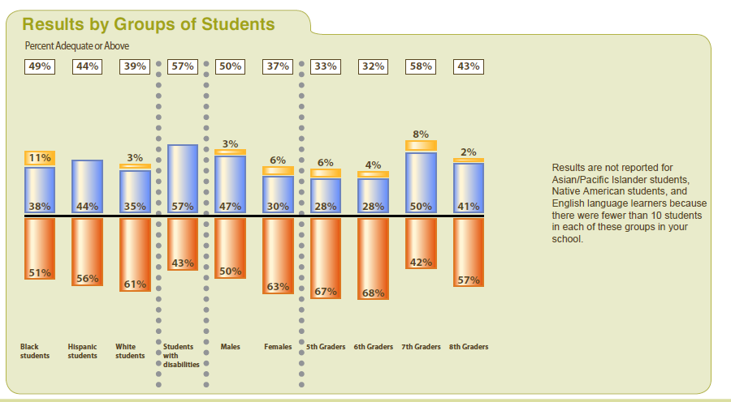
Data Disaggregated by Groups of Students: Cleveland Example
Notes:
when data disaggregated, what did they see and how did it impact their understanding of issues?

Slide 36
Polling Question #3
Based on your review of data so far, what is the most significant issue your school/district is facing?
  Racial/ethnic differences
  Gender differences
  Grade differences
  Meeting the strengths and needs of Special Education students
  Meeting the strengths and needs of other special populations

Slide 37
Questions?
If you have a question for the presenter, please type it in the Q & A Pane or email sssta@air.org.
?
?
?

Slide 38
Identifying the Type of Programmatic Interventions Needed to Address Target Areas

Slide 39
The Second Challenge: How to Select the Type of Programmatic Intervention
Notes:
Tie back to slide where say data is key…

Slide 40
Where Do You Intervene?
Provide coordinated, intensive, sustained, culturally competent, individualized, child- and family- driven and focused services and supports that address needs while building assets.
Implement strategies and provide supports that address risk factors and build protective factors for students at risk for severe academic or behavioral difficulties.
Universal prevention & youth social skill development approaches, caring school climate, positive & proactive approach to discipline, personalized instruction, cultural competence, & strong family involvement.

Slide 41
Where Do You Intervene?

Slide 42
Where Do You Intervene?

Slide 43
Where Do You Intervene?
Family Support & Engagement
Peer Attitudes, Behavior & Social & Emotional Capacities
Teacher Support, Pedagogy & Conditions for Teaching
Classroom Environment & Conditions for Learning

Slide 44
Where Do You Intervene?

Slide 45
Where Do You Intervene?

Slide 46
Polling Question #4
At what level of intervention is your school/district/State most focused?
  Universal: building a school-wide foundation
  Targeted: intervene early & provide focused youth
  development activities
  Intensive: provide individualized intensive supports
  More than one of the above

Slide 47
Questions?
If you have a question for the presenter, please type it in the Q & A Pane or email sssta@air.org.
?
?
?

Slide 48
Selecting Programmatic Interventions That Can Be Implemented Effectively within a School or District

Slide 49
What Criteria Should Be Used to Evaluate
Programmatic Interventions?
Outcomes
Information on differential effects
Cost and cost benefits
Staffing and logistical implications
Flexibility
Compatibility
Training and support needs
Implications for instructional time
External support needed & available

Slide 50
Bottom Line
Not all programmatic interventions are equal due to different:
  Notions of evidence
  Depth of evidence
  Types of outcome data collected
  Criteria for selection on a particular “list”
There is a whole range of programmatic interventions. (See http://safesupportiveschools.ed.gov/index.php?id=32.)
Every list of programmatic interventions has its own focus and criteria.
  Mythological standards for inclusion
  Depth of evidence
  Importance of randomized control trials
  Number of experimental studies (WWC vs. Blueprints)
  Focus

Slide 51

Bottom Line
Look for underlying design principles of each program.
Make sure school interventions align with:
  Each other
    Pedagogical assumptions
    Language
    Demands on teachers and students
  School structure
    Schedule
    Staffing patterns
  NOTE: structure can be re-engineered to align with the intervention
  School culture
    Interventions have to be consistent with the school culture OR become part of the school culture.

Slide 52
Bottom Line
Be data informed in your choices—don’t throw solutions, or parachute programs, at problems.
Do not exhale after you identify the intervention—plan, monitor, evaluate, and refine.

Slide 53
The Glass May be “Half-Filled”: The Bullying Example
Campbell Collaboration meta-analysis of 44 program evaluations
  Overall, programs are effective.
  Bullying decreased by 20-23%.
  Victimization decreased by 17-20%.
    If 20% in School of 1000 with a bullying rate of 30%, this meant a drop from 300 students being bullied to 240 students being bullied.
  Programs worked better:
    In Norway
    With older children
Citation ▪ 3

Slide 54
The Glass May be “Half-Filled”:The Efficacy/Effectiveness Gap Example
  There is a difference between efficacy results and effective results.
    Interventionists may be less skilled and pressed by competing demands (e.g., graduate students versus teachers).
    Treatment students may be more complex.
    The intensity of effort and expectation may be different.
  Hence, it is important to examine the implementation records for interventions.

Slide 55
Did the Intervention Address the Right
Fish?
Did it address cultural and linguistic differences or provide information that can be employed to address cultural differences?
Did it address variation in impact among different individuals who received the treatment?
Citation ▪ 2

Slide 56

What is the Target of the Intervention?
  Environmental Features or Conditions for Learning
  Risk Factors
  Protective Factors
  Assets

Slide 57
How Can an Intervention Be Unpacked?
What is it that really makes the difference?
What are the mechanisms of change?
Notes:
Please make the box black

Slide 58
Variation of Impact: Examples
One Evidence-Based Universal Intervention
  Look at class as a whole—little impact
  Look at the most aggressive kids—impact
  Look at girls—little impact
  Look at boys—impact
One Evidenced-Based Treatment Intervention
  Youth with serious antisocial behavior—yes
  In psychiatric crisis—no

Slide 59
Was there an Efficacy/Effectiveness Gap:
Did the Study Forget The Water?
The significance of the
water
2 dangers:
  Context stripping
  Ignoring the role of context
Contextual factors:
  Readiness
  Capacity to implement
    explicit
    intrinsic, but important
Citation ▪ 1

Slide 60
Why Is the Fidelity of Implementation
Important?
Example from Evidenced-Based Substance Abuse Prevention Intervention
Citation ▪ 4
Notes:
Weekly marijuana use. WILL LOOK FOR MORE RECENT STUDY.

Slide 61

What Costs Should Be Considered?
Cost of implementing a programmatic intervention:
Can we afford it?
Cost effectiveness of a programmatic intervention:
Can we REALLY afford it?
Long-term cost benefits of programmatic intervention:
Can we afford to not do it?

Slide 62
Cost Considerations: Juvenile Program Costs Example
Citation ▪ 5

Slide 63
Cost Considerations: Cost Benefit
Example
Example of an Evidence-Based
Juvenile Justice Intervention
Benefit-Cost Ratio: $43.70
Citation ▪ 5

Slide 64
Polling Question #5
Based on your past experience, which of the following do you anticipate providing the greatest challenge as you select programmatic interventions for your school, district or State?
  School/district/State culture
  Incompatibility with other programs
  Lack of appropriate staff to implement
  Securing other needed resources
  Time it will take to get it approved to stay on
  schedule
  None of the above

Slide 65
Take Aways
Establish school climate team (ideally pre-existing group) that will work together throughout school climate improvement process. (See SSSTA’s Webinars on school climate teams.)
Thoroughly examine a range of data, including disaggregated school climate survey data, to identify target areas.
Ensure you identify the appropriate intervention types for your students’/school’s needs – Look for interventions that have been demonstrated to accomplish:
  the types of improvements you want
  with the types of student, staff, and implementation capacities you have
  in similar settings
  that can align with other things that are going on in your school and district.
Refer to resources that can help teams.
  Systematically undergo improvement process (SSSTA’s Identifying and Implementing Programmatic Interventions, NIRN’s Installation Stage Assessment).
  Locate potential programmatic interventions (SSSTA’s List of EBP Resources).

Slide 66
Questions?
If you have a question for the presenter, please type it in the Q & A Pane or email sssta@air.org.
?
?
?

Slide 67
Citations
NIRN. (2011). Assessment of Implementation Stages. Retrieved from http://sisep.fpg.unc.edu/sites/sisep.fpg.unc.edu/files/resources/Installation_Stage_Assessment.docx on December 5, 2011.
Doll, B., Zucker, S., & Brehm, K. (2004). Resilient classrooms: Creating healthy environments for learning. New York: Guilford Press.
Ttofi, M.M., Farrington, D.P., & Baldry, A.C. (2010). Effective programs to reduce school bullying. In D.W. Springer and A.R. Roberts (Eds.), Juvenile Justice and Delinquency (pp. 167-185). Sudbury, Mass: Jones and Bartlett, in press.
Botvin,G.J., Baker,E., Dusenbury,L., Botvin,E.M., Diaz,T. (1995). JAMA, 273, 1106-1112.
Osher, D. M., & Quinn, M. M., Poirier, J. M., & Rutherford, R. B. (2003). Deconstructing the pipeline: Using efficacy, effectiveness, and cost-benefit data to reduce minority youth incarceration. New Directions for Youth Development, 2003 (99), 91–120.

Slide 68
Upcoming Webinar
Increasing Survey Response Rates and Engagement for Family, School Staff, and Special Populations
January 18, 2012 4:00 pm − 5:30 pm ET
January 19, 2012 11:00 am − 12:30 pm ET
The FY11 schedule of Safe and Supportive Schools TA Center Webinars will be posted as soon as it is available.

