Slide 1
Welcome to Today’s Webinar! Survey Administration
This event will start at 11:00 am EDT.

Slide 2
Welcome to Today’s Webinar
Audio Information
Dial: 888-324-6989
Conference ID: 9569820
If you have technical difficulties logging
into the web-based portion of the event,
please contact Live Meeting Customer
Support at 1 (866) 493-2825.
If you have any questions about the Live
Meeting technology or the Webinar,
please contact SSSTA at sssta@air.org.

Slide 3
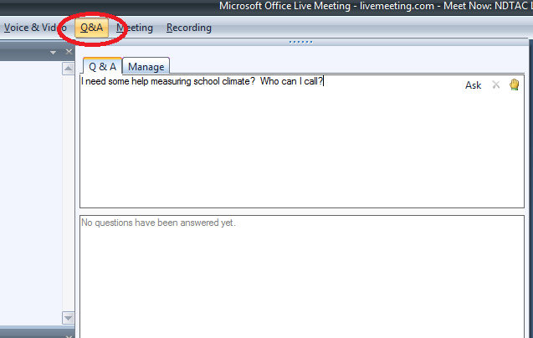
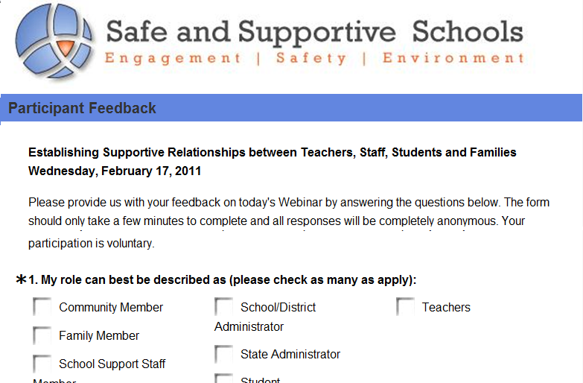
Questions, Event Evaluation & Contact Information
Q&A
Evaluation
If you have a question for the presenters, please type it in the Q & A Pane or email sssta@air.org during the Webinar.
An event evaluation will appear as the last slide in the presentation. Please input your answers directly into the slide. All answers are completely anonymous and are not visible to other participants.
For assistance during the Webinar, please contact
the Safe and Supportive Schools Technical Assistance Center
at sssta@air.org.

Slide 4
The Safe and Supportive Schools Technical Assistance Center
Funded by the U.S. Department of Education’s Office of Safe and Healthy Students.
Provides training and support to states, including 11 grantees funded under the Safe and Supportive Schools Program and other state administrators; administrators of districts and schools; teachers; support staff at schools; communities and families; and students.
Goal is to improve schools’ conditions for learning through measurement and program implementation, so that all students have the opportunity to realize academic success in safe and supportive environments.
*The content of this presentation was prepared under a contract from the U.S. Department of
Education, Office of Safe and Healthy Students to the American Institutes for Research
(AIR). This presentation does not necessarily represent the policy or views of the U.S.
Department of Education, nor do they imply endorsement by the U.S. Department of
Education.

Slide 5
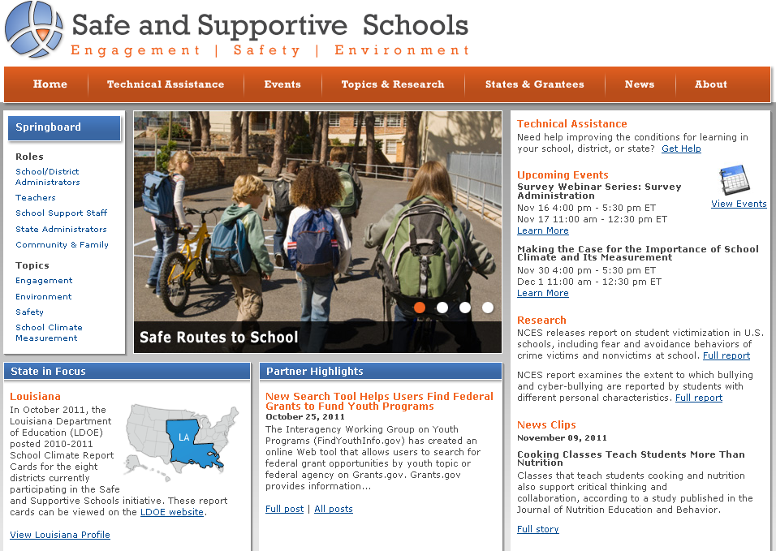
Safe and Supportive Schools Website
http://safesupportiveschools.ed.gov

Slide 6
Archived Webinars
Archived webinars cover the following school climate survey topics in greater detail:
Survey Management
http://safesupportiveschools.ed.gov/index.php?id=9&eid=6
Survey Development
http://safesupportiveschools.ed.gov/index.php?id=9&eid=8
Analysis of survey data
http://safesupportiveschools.ed.gov/index.php?id=9&eid=17
Reporting and dissemination
http://safesupportiveschools.ed.gov/index.php?id=9&eid=20

Slide 7
Survey Administration
Sally Ruddy, Ph.D., American Institutes for Research
Notes:
7

Slide 8
Polling Question #1
Which of the following best describes your current role?
State Education Personnel
District or School Administrator
Teacher or School Support Staff
Community or Family Representative
Student
Researcher
Other
Notes:
As participants respond, discuss how material today will relate to the various audiences identified here. Characterize pattern as people answer polling question.

Slide 9
Polling Question #2
Have you ever been the point person for administering surveys for a school or school district?
Yes
No
Notes:
As participants respond, discuss how material today will relate to the various audiences identified here. Characterize pattern as people answer polling question.

Slide 10
Agenda
1
Identifying respondents and selecting modes of data collection
2
Planning logistics
3
Preparing materials
4
Collecting data
5
Providing results

Slide 11
Importance of Good Survey Administration Practices
Our archived Survey Development webinar focused on an important step in ensuring sound data – creating a survey instrument that has valid and reliable measures.
Today we will talk about another important factor in ensuring sound data — how school climate surveys are administered.
We will cover such things as:
Choosing the most appropriate mode for specific respondents —students, staff, families (parents/guardians);
Conducting administration activities in a timely fashion; and
Attending to best practices when planning logistics, preparing administration materials, and collecting data.

Slide 12
Identifying Respondents and Selecting Modes of Data Collection

Slide 13
Respondents: Students, Staff, Families
Some initial questions —
Students:
Which students, from which schools?
Where and when will they take the survey?
Staff:
Which staff — Teachers only, all teaching staff, all staff?
Full and part time, occasional, subs?
Where and when will staff fill out the survey?
Families:
Which parent?
About which child?
Where/how will families fill out the survey and how will they get it?

Slide 14
Modes of Survey Administration
Surveys can be interviewer-assisted (in person or on phone) or self-administered (respondents fill out themselves).
We now have many data collection modes:
Paper and pencil, in-person, telephone-assisted, computer-assisted (web-based or e-mail only)
Various combinations (e.g., CAPI: computer assisted personal interviews)
What is the most appropriate mode for each respondent group?
We will focus on self-administered surveys and on paper and web-based modes of administration.
Citation ▪ 1
Notes:
Small Ns are fine
Readability matters more than results
Important to track the time it takes to administer
High quality surveys and polls always provide adequate budget and time for pretesting questionnaire(s) and field procedures. A pretest of the questionnaire and field procedures is the only way of finding out if everything "works"especially if a survey employs new techniques or a new set of questions. Because it is rarely possible to foresee all the potential misunderstandings or biasing effects of different questions or procedures, it is vital for a well-designed survey operation to include provision for a pretest. All questions should be pretested to ensure that questions are understood by respondents, can be properly administered by interviewers, and do not adversely affect survey cooperation. In circumstances where one is uncertain about the best design or any critical component of such a design, split sample experiments, which systematically compare the effects of two or more alternatives, should be included either prior to or as part of the pretesting process to select the most appropriate or effective design(s) or component(s).
[text from AAPOR]

Slide 15
Paper vs. Online — General Considerations
Paper
Needs no access to computers.
Needs no familiarity with computers.
Respondents need only a pen or pencil.
Paper flow needs to be managed (delivery, collection of forms).
Possibility of lost forms, respondent errors (filling in more than one circle, etc.)
May be more expensive (requires careful printing, scanning).
Scanners require clean, flat survey forms.
Citations ▪ 3,4,5

Slide 16
Paper vs. Online — General Considerations (cont.)
Online
Secured data with less chance for error
Web-based surveys generally produce faster responses.
No printing/scanning costs, but expense of programming
Commercially available online platforms (e.g., Survey Monkey, Zoomerang, Survey Gizmo, WebSurveyor, etc.)
However, districts may already have data systems (e.g., Naviance, eSchool, Aesop).
Respondents need access to and familiarity with computers.
Citation ▪ 2
Notes:
I do not recommend one over any other; I mean to point out that they exist and may be a useful resource to districts that do not already have their own platforms for electronic data gathering from respondents.

Slide 17
Modes for Specific Respondents
Students
Paper: Easy, familiar
Can be done in intact classes (e.g., homerooms).
Online: Need access to school computers/lab.
Should be administered in school setting; students should not fill out at home.
Staff
Paper: Can do onsite and turn in with student surveys.
Need sealable envelopes (or stamped addressed envelopes if mail-in option)
Online: Can do at home or at school
May be easier for teaching/office staff, but more difficult for others (janitors, bus drivers, etc.)
Families
Paper: Need stamped addressed envelopes for mail-back.
Online: Computer access/familiarity may be a bigger problem.
Citations ▪ 3,4,5

Slide 18
Polling Question #3
Do you have experience administering a paper or online survey?
Yes, both
Yes, paper only
Yes, online only
Neither
Notes:
As participants respond, discuss how material today will relate to the various audiences identified here. Characterize pattern as people answer polling question.

Slide 19
Questions?
If you have a question for the presenter, please type it in the Q & A Pane or email sssta@air.org.
?
?
?

Slide 20
Planning Logistics

Slide 21
Start Planning Early
Planning is the most important phase of survey administration!
Begin working with LEAs and schools as soon as you know you are going to field a school climate survey.
Start decision-making for selecting:
Contractors - data collection, printing, scanning contractors
Allow lead time for scheduling, mock ups, pricing options, etc..
Help from sampling statistician, measurement expert
All players need to know what is going to happen when, and how it is going to happen
Players include LEA and school staff, contractors, respondents.

Slide 22
Begin Working with Schools
Work with schools to establish a data collection window
Administer toward the end of the school year:
Anchors questions that ask about “this school year…”
If ongoing, collect at same time each year for cross-time comparisons
Avoid conflicts with other surveys/assessments, other school activities
Identify a survey coordinator in each building
Your main point of contact with the school through all 3 phases
Manages flow of materials and online logistics
Supervises survey administrators, instructions, training
Consider establishing a “Help Line” for coordinators, administrators, respondents.

Slide 23
Decision: Census vs. Sample Survey
A census survey means that all respondents in a group are surveyed.
Can provide accurate, unbiased description of the population.
Assuming adequate response rate and representative samples of subgroups.
Can yield the largest number of respondents and adequate subgroup sizes.
May be least disruptive to school environment.
Cost considerations: May be too expensive to include all students, staff and/or families connected to the school.
Note: You can mix census and sample per respondent group
(e.g., all students but sample of staff and/or families).
Citations ▪ 3,4
Notes:
Sampling should be designed to guard against unplanned selectiveness. A survey's intent is not to describe the particular individuals who, by chance, are part of the sample, but rather to obtain a composite profile of the population. In a bona fide survey, the sample is not selected haphazardly or only from persons who volunteer to participate. It is scientifically chosen so that each person in the population will have a measurable chance of selection. This way, the results can be reliably projected from the sample to the larger population with known levels of certainty/precision.
Critical elements in an exemplary survey are: (a) to ensure that the right population is indeed being sampled (to address the questions of interest); and (b) to locate (or "cover") all members of the population being studied so they have a chance to be sampled. The quality of the list of such members (the "sampling frame")whether it is up-to-date and complete is probably the dominant feature for ensuring adequate coverage of the desired population to be surveyed. Where a particular sample frame is suspected to provide incomplete or inadequate coverage of the population of interest, multiple frames should be used.
Virtually all surveys taken seriously by social scientists, policy makers, and the informed media use some form of random or probability sampling, the methods of which are well grounded in statistical theory and the theory of probability. Reliable and efficient estimates of needed statistics can be made by surveying a carefully constructed sample of a population, provided that a large proportion of the sample members give the requested information. The latter requires that careful and explicit estimates of potential non response bias and sample representativeness be developed.
[text from AAPOR]

Slide 24
Decision: Census vs. Sample survey (cont.)
A sample may be less expensive (fewer respondents, but cost of statistical help).
Need to systematically select a sample at random to minimize bias.
In school settings, stratified random sampling is often done (strata = grades).
All possible respondents or units (classrooms, groups) in each stratum (grade) have an equal chance of being selected.
For example, choose every nth student or classroom or period (can use a random-number generator).
Important that sample does not self-select.
Citations ▪ 3,4
Notes:
Sampling should be designed to guard against unplanned selectiveness. A survey's intent is not to describe the particular individuals who, by chance, are part of the sample, but rather to obtain a composite profile of the population. In a bona fide survey, the sample is not selected haphazardly or only from persons who volunteer to participate. It is scientifically chosen so that each person in the population will have a measurable chance of selection. This way, the results can be reliably projected from the sample to the larger population with known levels of certainty/precision.
Critical elements in an exemplary survey are: (a) to ensure that the right population is indeed being sampled (to address the questions of interest); and (b) to locate (or "cover") all members of the population being studied so they have a chance to be sampled. The quality of the list of such members (the "sampling frame")whether it is up-to-date and complete is probably the dominant feature for ensuring adequate coverage of the desired population to be surveyed. Where a particular sample frame is suspected to provide incomplete or inadequate coverage of the population of interest, multiple frames should be used.
Virtually all surveys taken seriously by social scientists, policy makers, and the informed media use some form of random or probability sampling, the methods of which are well grounded in statistical theory and the theory of probability. Reliable and efficient estimates of needed statistics can be made by surveying a carefully constructed sample of a population, provided that a large proportion of the sample members give the requested information. The latter requires that careful and explicit estimates of potential non response bias and sample representativeness be developed.
[text from AAPOR]

Slide 25
Oversampling and Weighting
Need enough respondents from subgroups to do a meaningful analysis.
Subgroup examples:
Students by grade, gender, race/ethnicity, English Language Learners (ELL), Individual Education Plan (IEP), free or reduced price lunch
Staff and families by their students’ characteristics or by other characteristics of interest (years of education, income)
Underrepresented subgroups can be oversampled and the data weighted.
Subgroup is weighted up to its actual proportion in the population.
If you plan to sample, enlist the help of a sampling statistician
(e.g., on-staff or consultant with data collection
contractor/partnering university).
Citations ▪ 3,4
Notes:
We usually say anything less than 100 has so much error in it (ie, large confidence intervals) that it is only suggestive at best, needing to be confirmed by other data (PS)
Weighting a non-representative sample does not make it representative. It does make it reflect population percentages, and you can say that, but weighting does not compensate for sample bias caused by non-representative sampling - PS

Slide 26
Polling Question #4
In your school/district have you typically used a census or sample survey?
Census
Sample
Both
Neither
Notes:
As participants respond, discuss how material today will relate to the various audiences identified here. Characterize pattern as people answer polling question.

Slide 27
Decision: Data Collection Windows
Students—Considerations
In school: 1 week for paper, 1-2 weeks for online
Administering in intact classrooms can be least disruptive to school day.
If online in school’s computer lab, assess how many computers there are vs. how many students to be surveyed.
Both paper and online:
Length of class period vs. length of survey
Pretest survey to see how long it takes all students to complete.
Remember that other activities may need to take place during period.

Slide 28
Decision: Data Collection Windows (cont.)
Staff and Families—Considerations
Need rosters from schools.
Provide cover letter with instructions, importance of school climate, etc..
Which parent? Add instruction for parent most familiar with school.
Which child? Add instruction to answer about child with next birthday.
Paper
Give staff option to fill out at school or mail back.
Mail-out to families and have them mail back in stamped addressed envelopes.
Online
Staff can complete at school or home.
Families can complete at home, work, libraries, etc..
Allow two week window for online and mail-backs.
Keeping online data collection window open for more than 2 weeks does not usually increase response rates.

Slide 29
Decision: Who Will Administer Student Surveys?
Can be administered by the classroom teacher or computer lab technician (if online).
Goal is to standardize administration and maintain a quiet atmosphere where students work alone.
The administrator:
Reads a script before the survey starts.
Distributes and collects paper survey instruments or makes sure students can access and save/exit their online survey.
Provides “usual accommodations” for students who need them.
Ensures only students with appropriate parental consent take survey.
Stays with students until all have completed the survey or period ends.

Slide 30
Decision: Active or Passive Parental Consent for Student Surveys?
Student survey topics requiring family consent procedures:
Political affiliations or beliefs of the student or the student’s family
Mental and psychological problems of the student or the student’s family
Sex behavior or attitudes
Illegal, anti-social, self-incriminating or demeaning behavior
Critical appraisals of other individuals with whom respondents have close family relationships
Legally recognized privileged or analogous relationships, such as those of lawyers, physicians, and ministers
Religious practices, affiliations, or beliefs of the student or the student’s parent
Income
Citation ▪ 6
Notes:
If your survey contains any of the above items and no students are required to submit to the survey when it is administered, then Federal law permits you to follow the passive consent procedures rather than the active consent procedures. Passive consent procedures require you to provide specific notice of the survey to the parent (or student who is 18 or an emancipated minor), the opportunity, upon request, to inspect the survey, and the opportunity to opt the student out of the administration of the survey.
On the other hand, if your survey contains any of the above items and any student is required to submit to the survey when it is administered, then Federal law requires the use of the active consent procedures. In other words, you must have obtained the prior written consent of the student’s parent (or the student if the student is 18 years old or an emancipated minor at any age), to require the student to take the survey.
Because we are not requiring that students participate in the survey, we are not requiring the use of active consent procedures. You may choose to administer the survey as a voluntary data collection and, if you ensure that this is done, then you may use the passive consent procedures rather than the active consent procedures.

Slide 31
Student Surveys and Waivers of Documented Family Consent
If administration is VOLUNTARY and the survey contains any of the subjects above, investigators may use PASSIVE consent:
Notify parents* about the survey, including the specific date of its administration and the types of questions included in the instrument.
Provide parents* with an opportunity to inspect the survey instrument prior to its administration.
Provide an opportunity to opt out of participation.
* or students who have turned 18 or are emancipated minors
Citation ▪ 6
Notes:
Safe and Supportive Schools grantees that chose to administer the assessment as a mandatory data collection would be instructed to obtain prior written parental consent or, in the case of a student who is an emancipated minor or has turned 18 years old, prior consent of the actual student and ensure that any personally identifiable information from the model assessment is disclosed only in compliance with the Family Educational Rights and Privacy Act (FERPA), 20 U.S.C. 1232g; 34 CFR Part 99. Safe and Supportive Schools grantees that chose to administer the assessment as a voluntary data collection would be instructed to complete the following activities: (1) notify parents or students who have turned 18 or are emancipated minors about the model assessment, including the specific date of its administration and the types of questions included in the assessment; (2) provide parents or students who have turned 18 or are emancipated minors with an opportunity to inspect the model assessment prior to its administration; (3) provide parents or students who have turned 18 or are emancipated minors with an opportunity to opt out of participation; and (4) ensure that any personally identifiable information from the model assessment is disclosed only in compliance with FERPA.

Slide 32
Student Surveys and Documented Family Consent
If administration is REQUIRED and contains any of the subjects above…must use ACTIVE consent.
Prior written consent of the parent* before administering the survey.
If the survey is funded, in whole or in part, by the U.S. Department of Education and students are required to take it, then parents* must provide written consent before students take the survey.
* or students who have turned 18 or are emancipated minors
Further information can be found at: PPRA@ED.Gov or 202-260-3887.
Also check your state or district rules re: active/passive parental consent.
Citation ▪ 6

Slide 33
Institutional Review Board (IRB) Submission
The purpose of an IRB is to ensure that appropriate steps are taken to protect the rights and welfare of humans participating as subjects in a research study.
In general, IRB approval is needed if data are to contribute to generalizable knowledge:
“Research means a systematic investigation, including research development, testing, and evaluation designed to develop or contribute to generalizable knowledge.”
Whether your study qualifies as “research” is determined by your IRB.
Check to see if your IRB has specific active/passive parental consent requirements.
Check your state or district regulations re: IRB approval or exemption.
Citations ▪ 7,8
Notes:
Note that non-participants almost always are kids who are higher risk, therefore results from voluntary surveys like these almost always have a positive bias, i.e., they over-state how good climate is because the kids with the worst perceptions of school climate invariably are over-represented among the missing

Slide 34
Polling Question #5
Have you submitted a survey to IRB?
Yes
No
Notes:
As participants respond, discuss how material today will relate to the various audiences identified here. Characterize pattern as people answer polling question.

Slide 35
Confidentiality and Anonymity
Anonymous surveys cannot link a form to a person.
Confidentiality means identifying information will never be given out nor individual data reported.
Respondents must be assured that their responses will not be made individually public or shared with people who know them or have power over them.
Confidential surveys may include names/bar codes linked to ID numbers:
Allows merging of responses with demographic or educational information.
For paper, can provide respondent’s name on a tear-off or peel-off label.
Result: Completed surveys have only the ID number when turned in.
Citation ▪ 4
Notes:
For some surveys, it is OK or even preferable for the respondents to be anonymous. This is particularly true when respondents are providing sensitive information or when it might be embarrassing or damaging to risk ever associating an individual’s name with survey responses. However, at other times, it is advantageous to know whose perception of school climate is being provided. In particular with students, identifying individual responses allows investigators to merge survey responses with other demographic and educational record information (that students are not very good at providing on their own) that then can provide the basis for understanding how different groups of students (e.g., ninth graders, or students who are Latino, or students who are off track to graduate) may have systematically different perceptions. This knowledge may be useful in targeting interventions where they can be the most good

Slide 36
Response Rates: General Considerations
Response Rate is the percentage of the sample invited to complete a survey that responds.
Non-responders to voluntary surveys are often individuals who may respond negatively.
Their responses are valuable; try your best to include them.
Student or staff surveys: U.S. Dept. of Education’s Institute for Education Sciences generally establishes a response rate target of 80%.
Family surveys: No agreed-upon target; get as many as you can.
If you have a low response rate, can do a non-response bias analysis:
Compares responders to non-responders across demographics.
If you find non-response bias, can weight results to account for it.
Citations ▪ 3,4
Notes:
Note that non-participants almost always are kids who are higher risk, therefore results from voluntary surveys like these almost always have a positive bias, i.e., they over-state how good climate is because the kids with the worst perceptions of school climate invariably are over-represented among the missing

Slide 37
Boosting Response Rates: Stakeholder Buy-In
Get buy-in from various stakeholder groups – starting with buy-in for measuring school climate.
How do you convince groups to buy in?
Explain to stakeholders why school climate is so vital to student outcomes.
Provide stakeholders with a way to collaborate on:
1) a clear plan of action to improve climate, and
2) ways that their voices will be heard during the planning and implementation processes.
More detail about stakeholder buy-in can be found in the School Climate and Measurement and Survey Management webinars, archived at http://safesupportiveschools.ed.gov/index.php?id=64.
Citations ▪ 2

Slide 38
Boosting Response Rates: Incentives
In general, incentives improve response rates.
Especially true for respondents who may not be interested in topic.
Effective incentives:
Are not coercive (i.e., participation is still voluntary).
Can be monetary or non-monetary (e.g., pen, school privilege).
Are either given in advance or immediately after survey completion.
Challenges:
Additional expense, but may reduce total survey cost.
Fewer follow-ups and call-backs.
May need to collect identifying information to provide incentives.
Citations ▪ 3,4

Slide 39
Boosting Response Rates: Specific Respondents
Students: Administer survey in school in a group setting.
Offer an alternate date later in the week to absentees.
Staff and Families: Offer multiple modes.
Staff: onsite or at home (paper or online) or mail-in option
Staff and Families:
Provide telephone option (800#).
Provide phone follow-ups or reminders (need 800# for call-backs).
Keep phone open for 2 weeks after data collection window closes.
Phone interviewers need to be trained to fill in paper questionnaire so administration is standardized.
For most survey questions, there will be few mode effects (i.e., difference in responses per mode).
Citations ▪ 3,4

Slide 40
Questions?
If you have a question for the presenter, please type it in the Q & A Pane or email sssta@air.org.
?
?
?

Slide 41
Preparing Materials

Slide 42
Finalize Administration Materials
Survey instruments for students, staff, families.
Paper: Send final draft to printer 8 weeks before data collection starts.
Online: Survey instrument should be programmed and tested at least 4 weeks before data collection starts.
Staff and family cover letters, instructions, and databases for mailing labels and send to printer.
Parental consent forms and send to printer.
Allow time to mail out to families 5 weeks before data collection starts.
If active consent, allow enough time for follow up of unreturned forms.
Instruction manuals for coordinators, administrators, and telephone interviewers (if phone or follow up options).

Slide 43
Instruction Manuals
Coordinator’s manual (use for training coordinators)
Introduction—LEA/state sponsors, data collection contractor, purpose, importance of school climate
Survey dates and materials—Dates and procedure for material flow/ preparing for online administration, length of student surveys, procedure/rosters for staff and/or family surveys
Guidance for survey administrators
Instructions for unassigned survey forms for new students
Cannot give unassigned students another student’s survey
Cannot photocopy surveys.
Date and how to return surveys
Help desk—Number and staffed dates/hours.

Slide 44
Instruction Manuals (cont.)
Administrator’s manual (use for training administrators)
Introduction—Same as for coordinators.
Before survey starts:
Discreetly ask students who are opted out to go to pre-assigned place.
Procedure for unassigned surveys
Special accommodations for students if possible
Student volunteer to collect surveys.
Read survey script:
Sponsors, purpose, importance of school climate
Not a test, entirely voluntary.
Take out quiet activity if finish early.
If surveying young children (grades 2-4), administrator should read survey out loud; students follow along and fill in bubbles.

Slide 45
Instruction Manuals (cont.)
Administrator’s manual (cont.)
While students taking survey:
Students should work independently, do the best they can.
If they have a question about what an item means, tell them it is “whatever it means to you.”
Do not give students “help” with questions.
Standardized administration = Sound data.
Time survey: Tell students when they have 10 min. left, etc..
At the end of the survey session:
Have volunteer collect surveys (signs across sealed envelope).
Administrator take envelope to school office or drop-off point.
If questions, contact school’s coordinator or call the Help Desk.

Slide 46
Collecting Data

Slide 47
Two Weeks Before Data Collection Starts
Paper: Student and staff questionnaires should be delivered to schools.
Know who will receive materials and where they will be stored.
Can be bundled and labeled for each classroom.
Paper surveys and cover letters should be mailed to families.
Online: Have program ready and fully tested (especially skip patterns).
Finalize the schedule for students to come to computer lab.
Train coordinators, administrators, and telephone interviewers (if phone or follow up options are offered).
Have Help Line and follow-up/call-back numbers in place.

Slide 48
After Data Collection
Paper
Onsite administration: collect paper surveys and send to scanning contractor.
Mail in surveys: Staff/families can mail back directly to contractor in stamped addressed envelope.
Staff/family phone interview: contractor collects questionnaires to send to scanning service all at one time.
Online
Shut down access to survey and secure data.
Secure server and transfer data by password-protected means (e.g., ftp site).
Both paper and online: Document administration procedures.

Slide 49
Providing Results

Slide 50
Providing Results: Data Analysis
Preparing School Climate Data
Data cleaning
Check for missing data and items with low response rates
Can be difficult items or “fall off.”
Check for “lazy” respondents (mostly one response option).
Minimize by using both positively and negatively worded items.
Decide what will be considered a “complete” survey.
Analyze the data--Psychometric analysis of scales
See previous webinars at: http://safesupportiveschools.ed.gov/index.php?id=64 for illustration and discussion of OSHS School Climate Model.
Further information on Data Analysis can be found in our archived webinar: http://safesupportiveschools.ed.gov/index.php?id=9&eid=17.
Notes:
be explicit about not just missing data in data cleaning, but also show them how to look for patterns of internally inconsistent responses, evidence of response sets such as nothing but strongly disagree for 20 questions in a row, obviously oppositional or nonsense responses written in, such as profanity or made-up words, etc. We usually experience between 5%-8% of cases needing to be excluded due to data cleaning criteria, so something in that range would not be uncommon. -- PS

Slide 51
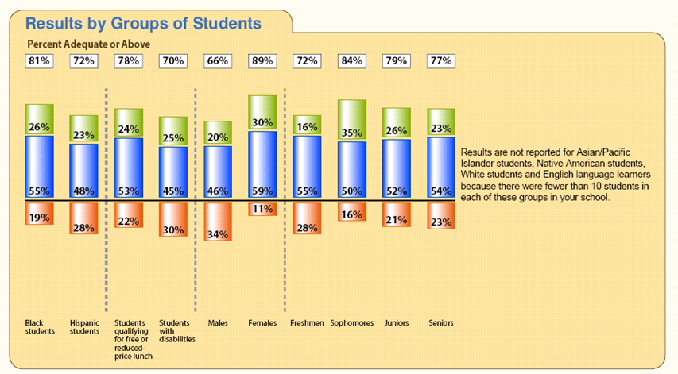
Providing Results: Reporting and Dissemination
Reports should be:
Clear
Concise
Easy to understand
Appropriate for the audience
Presented in a non-blaming, helpful manner
Timely
School climate reports:
Can show how your school climate scores compare with state or national surveys using the same measures.
Can show how your school climate scores compare with an aspirational standard that reflects your vision for your school’s climate.
Further information on Reporting and Dissemination can be found in our archived webinar: http://safesupportiveschools.ed.gov/index.php?id=9&eid=20.

Slide 52
Questions?
If you have a question for the presenter, please type it in the Q & A Pane or email sssta@air.org.
?
?
?

Slide 53
Upcoming Webinars
Making the Case for the Importance of School Climate and Its Measurement November 30, 2011 4:00 pm − 5:30 pm ET
December 1, 2011 11:00 am − 12:30 pm ET
The FY11 schedule of Safe and Supportive Schools TA Center Webinars will be posted as soon as it is available.

Slide 54
Survey Administration Citations
Tourangeau, R. and Smith, T.W. (1996), “Asking Sensitive Questions: The Impact of DataCollection Mode, Question Format, and Question Context.” Public Opinion Quarterly, 60: 275-304.
Safe Supportive Schools Technical Assistance Center webinar, Survey Management, March 2 and 3, 2011, archived at http://safesupportiveschools.ed.gov/index.php?id=64.
Fowler Jr., F. J. (2009) Survey Research Methods (4th Edition). Washington, DC: Sage.
Groves, R. M., Fowler Jr., F. J., Couper, M. P. , Lepkowski, J. M., Singer, E., &. Tourangeau, R. (2004). Survey Methodology. Hoboken, NJ: Wiley.
Couper, M.P & Miller, P. V. (2008). “Web Survey Methods: Introduction.” Public Opinion Quarterly, 72: 831-835.
Harper, K. (December, 2010). Measuring School Climate. Presented to the Safe and Supportive Schools Grantee Meeting, Washington, DC.
Bohrnstedt, G., Boruch, R., Secada, W. (2010). Workshop on the Protection of Human Subjects in Education Research. Workshop presented at the 2010 annual meeting of the American Educational Research Association (AERA).
IRB FAQs for Survey Researchers, found at: http://www.aapor.org/Content/aapor/Resources/ForResearchers/InstitutionalReviewBoards/IRBFAQsforSurveyResearchers/default.htm.
Notes:
54

